Slide 1
IT694
Computer Networks
Week10_Lec3

Slide 2
Dijkstra’s link-state routing algorithm
centralized: network topology, link costs known to all nodes
accomplished via “link state broadcast”
all nodes have same info
computes least cost paths from one node (“source”) to all other nodes
gives forwarding table for that node
iterative: after k iterations, know least cost path to k destinations
notation
c_{x,y}: direct link cost from node x to y; = ∞ if not direct neighbors
D(v): current estimate of cost of least-cost-path from source to destination v
p(v): predecessor node along path from source to v
N': set of nodes whose least-cost-path definitively known

Slide 3
Dijkstra’s link-state routing algorithm
1 Initialization:
2 N' = {u} /* compute least cost path from u to all other nodes */
3 for all nodes v
4 if v adjacent to u /* u initially knows direct-path-cost only to direct neighbors */
5 then D(v) = c_{u,v} /* but may not be minimum cost! */
6 else D(v) = ∞
7
8 Loop
9
10
11
12
13
14
15 until all nodes in N'
find w not in N' such that D(w) is a minimum
add w to N'
update D(v) for all v adjacent to w and not in N' :
D(v) = min ( D(v), D(w) + c_{w,v} )
/* new least-path-cost to v is either old least-cost-path to v or known
least-cost-path to w plus direct-cost from w to v */

Slide 4
Dijkstra’s algorithm: an example
v
w
x
y
z
Step
0
1
2
3
4
5
N'
D(v),p(v)
D(w),p(w)
D(x),p(x)
D(y),p(y)
D(z),p(z)
u
2,u
5,u
1,u
∞
∞
D(w),p(w)
5,u
4,x
3,y
3,y
5
Initialization (step 0):
For all a: if a adjacent to u then D(a) = c_{u,a}
v
3
w
2
5
u
2
1
z
3
1
2
x
y
1

Slide 5
Dijkstra’s algorithm: an example
v
w
x
y
z
Step
0
1
2
3
4
5
N'
D(v),p(v)
D(w),p(w)
D(x),p(x)
D(y),p(y)
D(z),p(z)
u
2,u
5,u
1,u
∞
∞
ux
D(w),p(w)
5,u
4,x
3,y
3,y
8 Loop
9
10
find a not in N' such that D(a) is a minimum
add a to N'
5
v
3
w
2
5
u
2
1
z
3
1
2
x
y
1

Slide 6

Dijkstra’s algorithm: an example
v
w
x
y
z
Step
0
1
2
3
4
5
N'
D(v),p(v)
D(w),p(w)
D(x),p(x)
D(y),p(y)
D(z),p(z)
u
2,u
5,u
1,u
∞
∞
ux
2,u
4,x
2,x
∞
D(w),p(w)
5,u
4,x
3,y
3,y
8 Loop
9
10
11
find a not in N' such that D(a) is a minimum
add a to N'
5
v
3
w
2
5
update D(b) for all b adjacent to a and not in N' :
D(b) = min ( D(b), D(a) + c_{a,b} )
u
2
1
z
3
1
2
D(v) = min ( D(v), D(x) + c_{x,v} ) = min(2, 1+2) = 2
x
y
1
D(w) = min ( D(w), D(x) + c_{x,w} ) = min (5, 1+3) = 4
D(y) = min ( D(y), D(x) + c_{x,y} ) = min(inf,1+1) = 2

Slide 7
Dijkstra’s algorithm: an example
v
w
x
y
z
Step
0
1
2
3
4
5
N'
D(v),p(v)
D(w),p(w)
D(x),p(x)
D(y),p(y)
D(z),p(z)
u
2,u
5,u
1,u
∞
∞
ux
2,u
4,x
2,x
∞
uxy
D(w),p(w)
5,u
4,x
3,y
3,y
8 Loop
9
10
find a not in N' such that D(a) is a minimum
add a to N'
5
v
3
w
2
5
u
2
1
z
3
1
2
x
y
1

Slide 8
Dijkstra’s algorithm: an example
v
w
x
y
z
Step
0
1
2
3
4
5
N'
D(v),p(v)
D(w),p(w)
D(x),p(x)
D(y),p(y)
D(z),p(z)
u
2,u
5,u
1,u
∞
∞
ux
2,u
4,x
2,x
∞
uxy
2,u
3,y
4,y
8 Loop
9
10
11
find a not in N' such that D(a) is a minimum
add a to N'
5
v
3
w
2
5
update D(b) for all b adjacent to a and not in N' :
D(b) = min ( D(b), D(a) + c_{a,b} )
u
2
1
z
3
1
2
D(w) = min ( D(w), D(y) + c_{y,w} ) = min (4, 2+1) = 3
x
y
1
D(z) = min ( D(z), D(y) + c_{y,z} ) = min(inf,2+2) = 4

Slide 9
Dijkstra’s algorithm: an example
v
w
x
y
z
Step
0
1
2
3
4
5
N'
D(v),p(v)
D(w),p(w)
D(x),p(x)
D(y),p(y)
D(z),p(z)
u
2,u
5,u
1,u
∞
∞
ux
2,u
4,x
2,x
∞
uxy
2,u
3,y
4,y
uxyv
8 Loop
9
10
find a not in N' such that D(a) is a minimum
add a to N'
5
v
3
w
2
5
u
2
1
z
3
1
2
x
y
1

Slide 10
Dijkstra’s algorithm: an example
v
w
x
y
z
Step
0
1
2
3
4
5
N'
D(v),p(v)
D(w),p(w)
D(x),p(x)
D(y),p(y)
D(z),p(z)
u
2,u
5,u
1,u
∞
∞
ux
2,u
4,x
2,x
∞
uxy
2,u
3,y
4,y
uxyv
3,y
4,y
8 Loop
9
10
11
find a not in N' such that D(a) is a minimum
add a to N'
5
v
3
w
2
5
update D(b) for all b adjacent to a and not in N' :
D(b) = min ( D(b), D(a) + c_{a,b} )
u
2
1
z
3
1
2
D(w) = min ( D(w), D(v) + c_{v,w} ) = min (3, 2+3) = 3
x
y
1

Slide 11
Dijkstra’s algorithm: an example
v
w
x
y
z
Step
0
1
2
3
4
5
N'
D(v),p(v)
D(w),p(w)
D(x),p(x)
D(y),p(y)
D(z),p(z)
u
2,u
5,u
1,u
∞
∞
ux
2,u
4,x
2,x
∞
uxy
2,u
3,y
4,y
uxyv
3,y
4,y
uxyvw
8 Loop
9
10
find a not in N' such that D(a) is a minimum
add a to N'
5
v
3
w
2
5
u
2
1
z
3
1
2
x
y
1

Slide 12
Dijkstra’s algorithm: an example
v
w
x
y
z
Step
0
1
2
3
4
5
N'
D(v),p(v)
D(w),p(w)
D(x),p(x)
D(y),p(y)
D(z),p(z)
u
2,u
5,u
1,u
∞
∞
ux
2,u
4,x
2,x
∞
uxy
2,u
3,y
4,y
uxyv
3,y
4,y
uxyvw
4,y
8 Loop
9
10
11
find a not in N' such that D(a) is a minimum
add a to N'
5
v
3
w
2
5
update D(b) for all b adjacent to a and not in N' :
D(b) = min ( D(b), D(a) + c_{a,b} )
u
2
1
z
3
1
2
D(z) = min ( D(z), D(w) + c_{w,z} ) = min (4, 3+5) = 4
x
y
1

Slide 13
Dijkstra’s algorithm: an example
v
w
x
y
z
Step
0
1
2
3
4
5
N'
D(v),p(v)
D(w),p(w)
D(x),p(x)
D(y),p(y)
D(z),p(z)
u
2,u
5,u
1,u
∞
∞
ux
2,u
4,x
2,x
∞
uxy
2,u
3,y
4,y
uxyv
3,y
4,y
uxyvw
4,y
uxyvwz
8 Loop
9
10
find a not in N' such that D(a) is a minimum
add a to N'
5
v
3
w
2
5
u
2
1
z
3
1
2
x
y
1

Slide 14
Dijkstra’s algorithm: an example
v
w
x
y
z
Step
0
1
2
3
4
5
N'
D(v),p(v)
D(w),p(w)
D(x),p(x)
D(y),p(y)
D(z),p(z)
u
2,u
5,u
1,u
∞
∞
ux
2,u
4,x
2,x
∞
uxy
2,u
3,y
4,y
uxyv
3,y
4,y
uxyvw
4,y
uxyvwz
8 Loop
9
10
11
find a not in N' such that D(a) is a minimum
add a to N'
5
v
3
w
2
5
update D(b) for all b adjacent to a and not in N' :
D(b) = min ( D(b), D(a) + c_{a,b} )
u
2
1
z
3
1
2
x
y
1

Slide 15
Dijkstra’s algorithm: an example
5
v
3
w
2
5
u
2
1
z
3
1
2
D(w),p(w)
5,u
4,x
3,y
3,y
x
y
1
resulting least-cost-path tree from u:
resulting forwarding table in u:
v
w
destination
outgoing link
v
x
y
w
x
(u,v)
(u,x)
(u,x)
(u,x)
(u,x)
route from u to v directly
u
z
x
route from u to all other destinations via x
y

Slide 16
Dijkstra’s algorithm: another example
v
w
x
y
z
x
D(v),
p(v)
D(w),
p(w)
D(x),
p(x)
D(y),
p(y)
D(z),
p(z)
9
Step
N'
0
u
7,u
3,u
5,u
∞
∞
5
7
4
1
uw
6,w
5,u
11,w
∞
8
2
uwx
6,w
11,w
14,x
u
3
w
y
z
2
3
uwxv
10,v
14,x
3
4
uwxvy
12,y
7
4
5
uwxvyz
v
notes:
construct least-cost-path tree by tracing predecessor nodes
ties can exist (can be broken arbitrarily)

Slide 17
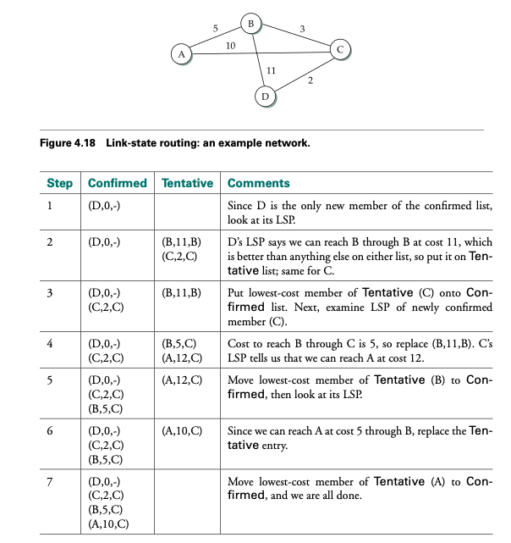

Slide 18
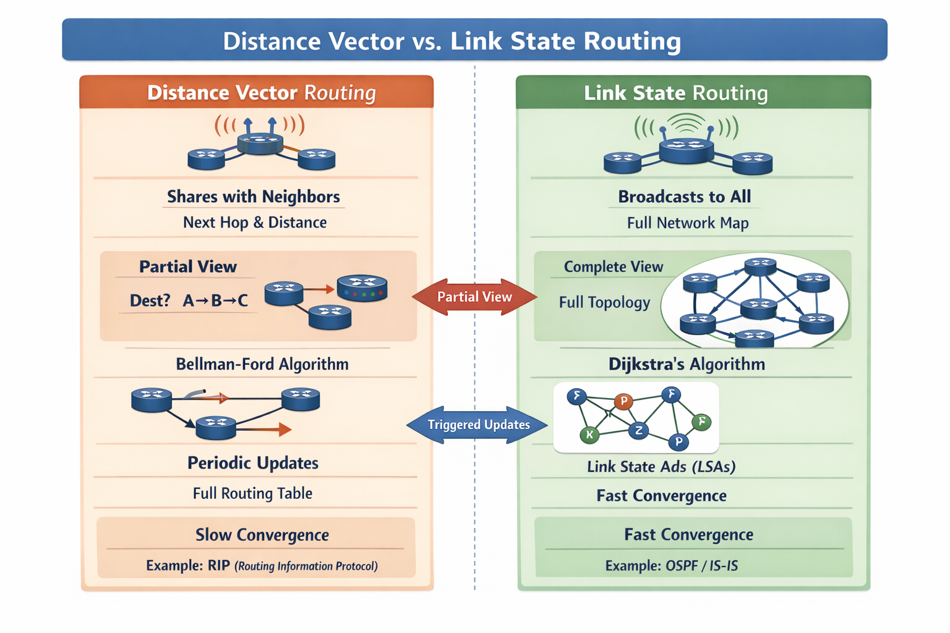

Slide 19
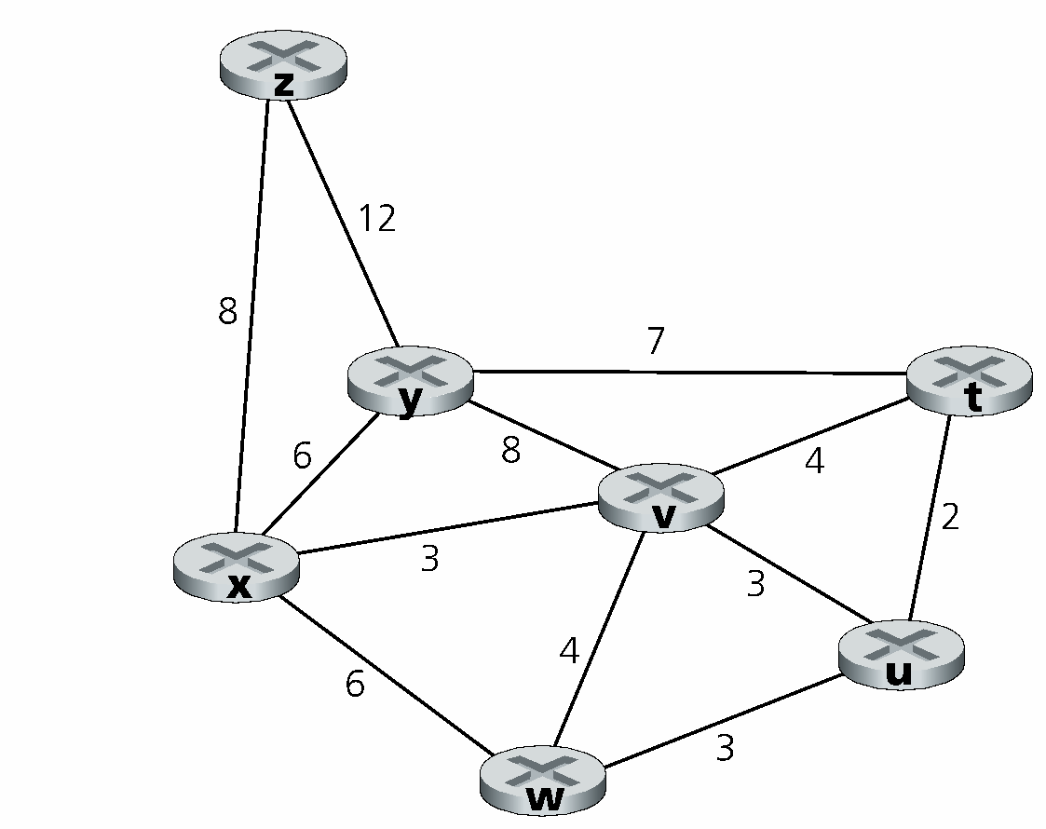
Compute the shortest path from t to all network nodes.

Slide 20
Step | N’ | D(u),p(u) | D(v),p(v) | D(w),p(w) | D(x),p(x) | D(y),p(y) | D(z),p(z)
0 | t | 2,t | 9,t | ∞ | ∞ | 4,t | 2,t
1 | ts | 2,t | 9,t | ∞ | ∞ | 4,t | 2,t
2 | tsu |  | 3,u | 5,u | ∞ | 4,t | 2,t
3 | tsuz |  | 3,u | 5,u | ∞ | 4,t
4 | tsuzv |  |  | 4,v | 6,v | 4,t
5 | tsuzvw |  |  |  | 5,w | 4,t
6 | tsuzvwy |  |  |  | 5,w

